Slide 1
Brain relaxation during craniotomy

Slide 2
Outline
Definition
Incidence and etiology of inadequate brain relaxation
Evaluation of brain relaxation
Management of brain relaxation

Slide 3
Brain relaxation
Ideal volume of intracranial contents in relationship to capacity of intracranial space that provides optimal operating condition

Slide 4
Intracranial content-space relationship

Slide 5
Intracranial volume and ICP relationship

Slide 6
Comparison
Intracranial pressure
the pressure in a closed cranium
an objective measure made with a transducer
Brain relaxation
a subjective assessment by the surgeon
the cranium and dura are opened

Slide 7
Volume-pressure curve

Slide 8
Incidence
Incidence of inadequate brain relaxation
Severe cerebral swelling: 5.0-6.1%
Mild to moderate brain swelling: nearly 30%

Slide 9
Etiology
Mismatch between the intracranial contents and space
The primary cause:
  Excessive volume from various lesions (Tumor,cysts, hematoma, traumatic injury)

Slide 10
Etiology
Others factors
  Excessive CSF (hydrocephalus)
  Excessive CBV from increase CBF (hypercapnia, high MAC)
  Reduced cerebral venous drainage (head-down, neck compression)
  Reduction in capacity of intracranial space (depressed cranial fracture)

Slide 11
Evaluation of brain relaxation
Prediction from preop intracranial hypertension
  Headache, nausea and vomitting, mental status change, papilloedema, pupillary dilatation, decerebrate, bulging fontanel/scalp flap
  Measurement of ICP
  CT scan: edema, shallow sulcus, midline shift, compressed basal cisterns

Slide 12
Pathophysiology of intracranial hypertension

Slide 13
Evaluation
Subjective assessment
  By direct inspection and palpation
  The most convenient
Grading
  5-point scale (ideal, less ideal, tense, bulging, worst)
  4-point scale (completely relax, satisfactory relax, firm, bulging)
  other (tight, adequate, soft)

Slide 14
Evaluation
Objective assessment
  subdural pressure measured when the cranium is opened while the dura is closed
  Subdural pressure <6-10 mmHg: brain swelling/herniation rarely occurs

Slide 15
Management of brain relaxation

Slide 16
Checklist
Oxygenation (oximetry or arterial blood gas)
Carbon dioxide (EtCO2 or PaCO2)
Hemoglobin
Blood pressure
Body position
Neck position
Imaging study
Masses
CSF drain
Volatile anesthetics
Vasodilators

Slide 17
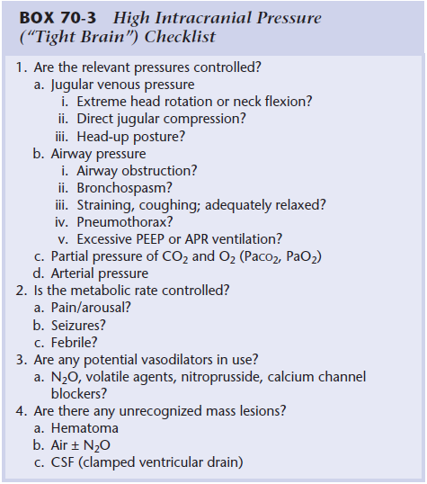

Slide 18
Hyperosmolar therapy
Mannitol and hypertonic saline
Extraction free water from brain tissue to intravascular space via osmotic gradient
No benefit in acute ischemic stroke or Intracerebral hemorrhage

Slide 19
Hyperosmolar therapy
Mannitol cause excessive urine output, electrolyte abnormalities, alteration in cardiac output and exacerbate cerebral edema in disrupted blood brain barrier patient
Hypertonic saline does not cause diuresis and hypovolemia
Risk of hypernatremia, hypokalemia, myelinolysis and pulmonary edema

Slide 20
Hyperosmolar therapy
Current evidence does not support choosing one agent over the other
In more recent studies, furosemide in combination with hyperosmolar agent does not significantly augment cerebral dehydration

Slide 21
Hyperventilation
Hypocapnia induced cerebral vasoconstriction and subsequent reduction of CBV and intracranial volume
reduction in CBF could render the brain at ischemic risk
Prophylactic prolonged hyperventilation correlates with poor 3 and 6 months outcomes
Maintain normocapnia and reserve hyperventilation as a temporary measure for brain relaxation

Slide 22
CSF drainage
Reduction of intracranial CSF, a component of intracranial content
Risk of neural injury, hematoma, infection and also cerebral herniation (if lumbar drainage)

Slide 23
Head-up tilt
Relocation of CSF from intracranial space to extracranial intrathecal space
Increase risk cerebral hypoperfusion, VAE and pneumocephalus
In head injured patients, head elevation to 30 degree significant decrease ICP with out affecting CPP and CBF.
In prone position, 10 degrees of reverse Trendelenburg position significantly decrease ICP

Slide 24
IV vs Inhalation anesthesia
IV anesthetics reduces CBF and CBV and also CMRO2 (flow-metabolism coupling)
High-MAC increase CBF and CBV
Several studies show small reductions in ICP and no difference in brain relaxation score with IV anesthetics compare with volatile anesthetics
The commonly used volatile agents is <0.5 MAC

Slide 25
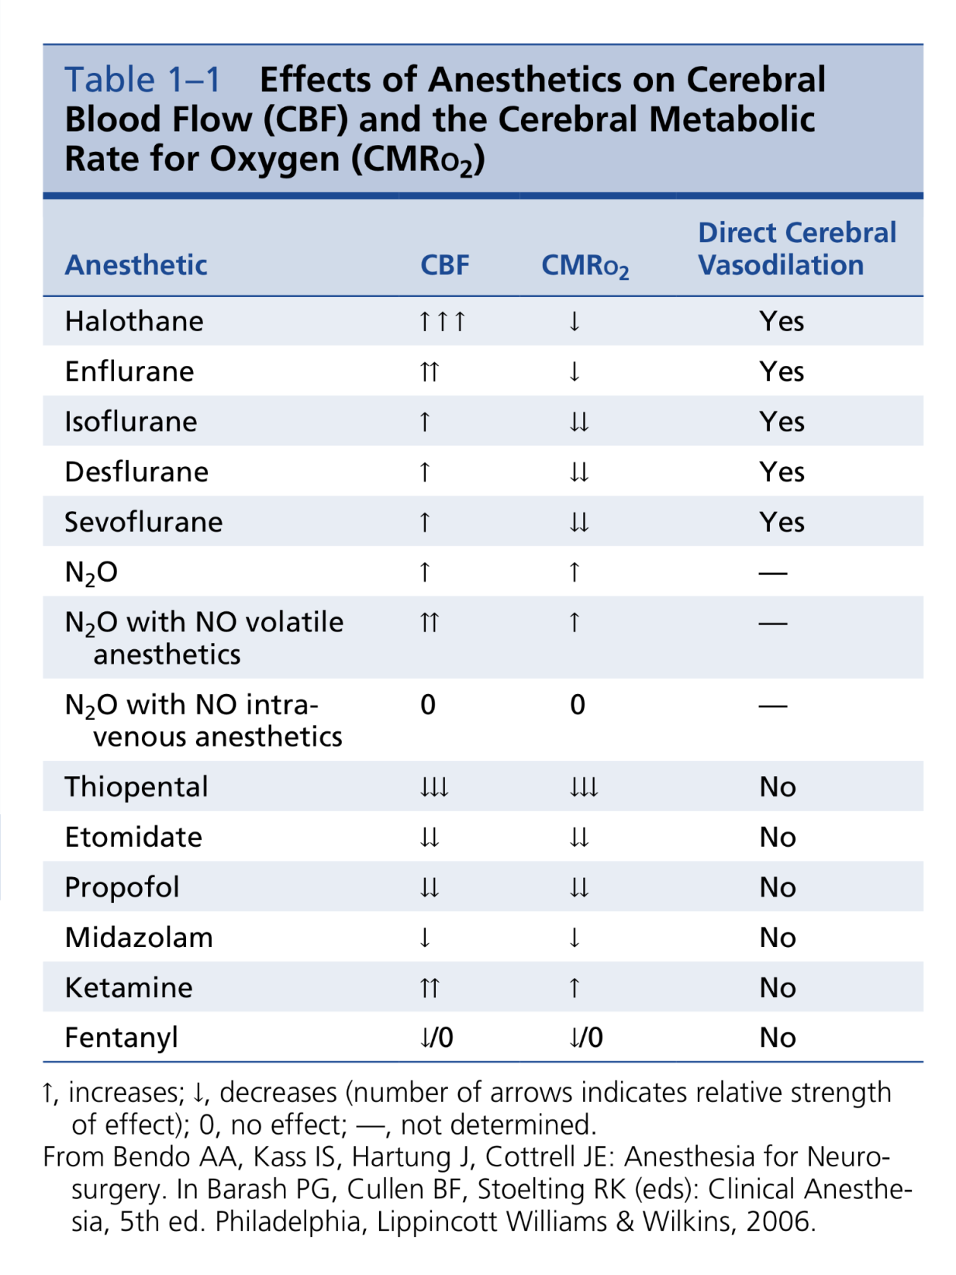

Slide 26
Steroids
Reduce vasogenic tumor-associated edema in patient undergoing brain tomor surgery (unclear mechanism)
The effect is delayed and peak at 24-48 hrs
Not recommend in patient with TBI, intracranial hemorrhage and ischemic stroke
Serious side effect: immunological suppression

Slide 27
Interventions
Treatment | Method | Advantages | Disadvantages | Speed of onset
Hyperventilation | Increase minute ventilation, keep PaCO2>3.33kPa | Effective | Reduce CBF | 5min
Mannitol | 0.25-1g/kg IV | Effective | Diuresis, hypovolaemia, renal dysfunction | 10min
Hypertonic saline | 3-7.2% hypertonic saline 30-150ml/hr | Effective | Hypernatremia, hypokalemia, myelinolysis | 10min
Head-up tilt | Reverse trendelenburg | Effective | Hypotension, VAE, pneumocephalus | <5min

Slide 28
Interventions
Treatment | Method | Advantages | Disadvantages | Speed of onset
IV anesthetisia | Propofol instead of volatiles | Cerebral vasoconstriction, less emergence agitation, less N/V | Higher cost | 10-20min
CSF drainage | Lumbar or ventricular drain | Reliable, ICP monitoring available | Invasive, infection, neurological injury, brain herniation | <5min
Furosemide | 10-20mg IV | Potentiate cerebral dehydration effect of mannitol | Hypovolaemia, hypokalemia | 30min
Steroids | Dexamethasone 4-10mg | Reduce peritumor oedema | Slow onset, not applicable in TBI | Hours

Slide 29
Thank you

